Slide 1



EconoGuide
Your mentor to financial empowerment

Slide 2

PROBLEM STATEMENT
“Empower Your Financial Future: Bridging the Knowledge Gap in Finance and
Markets”
In today's rapidly evolving financial landscape, individuals face a significant
challenge in staying informed and confident about their financial decisions. Many lack the essential knowledge required to navigate the complexities of investments, markets, and personal finance effectively. This knowledge gap often leads to missed opportunities, uninformed decisions, and limited financial growth.

Slide 3





Meet the Team
Vaibhav Kundu
Ahana Biswas
Archismwan Chatterjee
Ayan Mondal

Slide 4
Why use our Website?
Vision
Our unique and engaging online platform is committed to promoting financial literacy. From novices hoping to understand the fundamentals of personal finance to seasoned professionals looking to sharpen their financial acumen, our website offers a wide variety of finance quizzes tailored to various skill levels.
Mission
At our Finance Quiz website, our mission is to make learning about finance engaging, accessible, and impactful for everyone. We envision a world where individuals from all walks of life have the knowledge and confidence to make informed financial decisions that lead to their long-term prosperity.

Slide 5
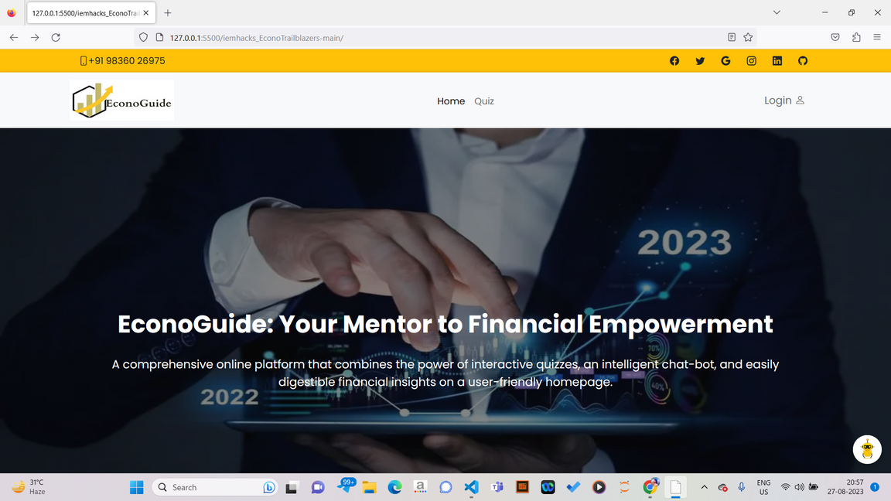
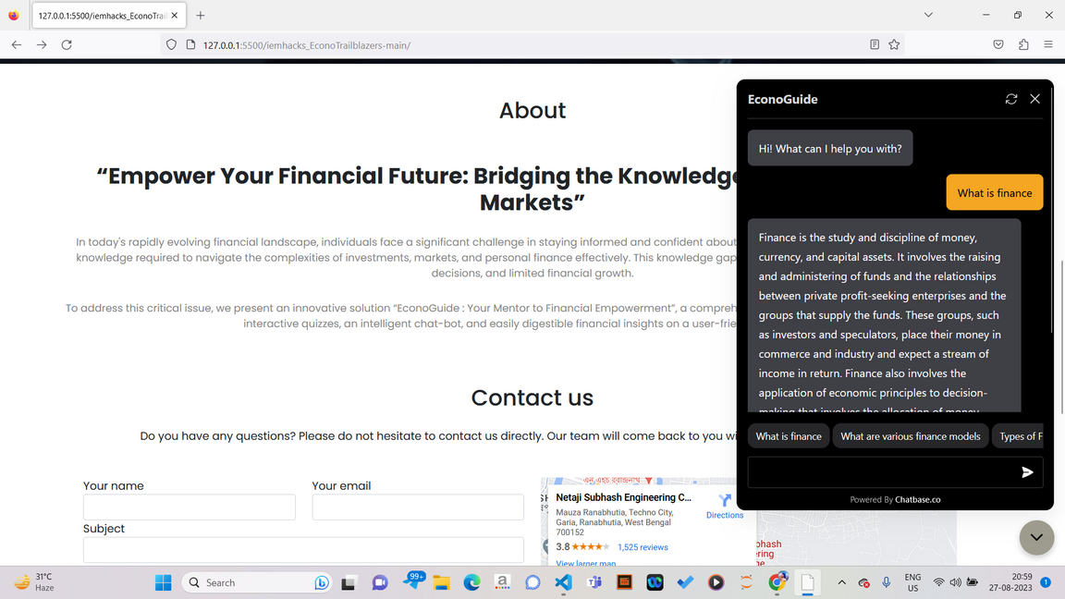
How EconoGuide looks

Slide 6
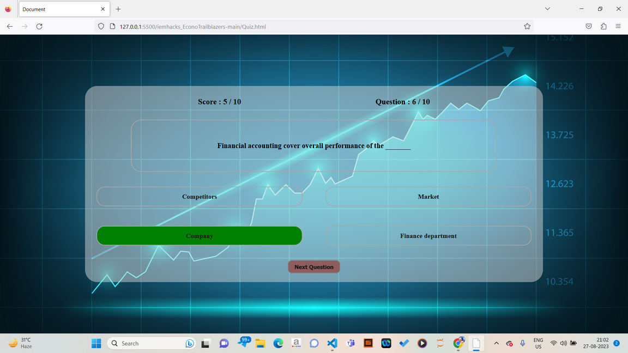
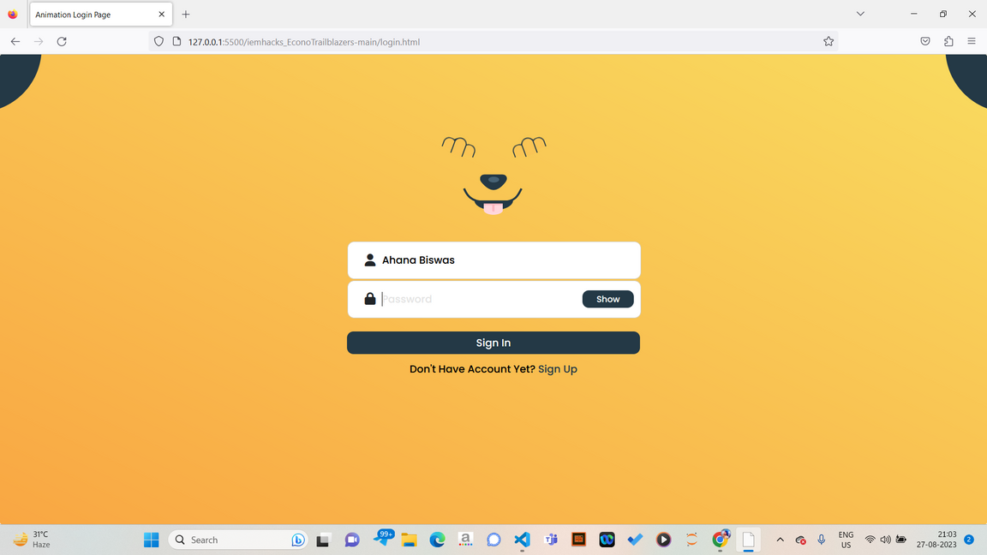

Slide 7


To lead people into a better financial health
Goals
To bridge the financial knowledge gap
Analysis of quiz results

Slide 8

USP
Personalised chatbot.
A provision of website makes it easier to access from anywhere.
Gamifying the medium of knowledge through quiz.
Generating revenue from targeted advertisements.

Slide 9

Target Audience
Students and Young-adults
Enterpreneurs
Traders and Investors
General Public
Educators and Trainers
Retirees and Pre-retirees

Slide 10

MARKET ANALYSIS
When it comes to what advantages we have in comparison to our competitors like Finwise, none of them uses a personalised chatbot.

Slide 11

Future Prospects
Predict stock prices and determine if it is a good time to buy a stock
Give updates related to stock prices
Generating revenue from targeted advertisements
Determine our core users

Slide 12

Thank You

